Slide 1
Sentiment Analysis for Sexual Assault Call Center

Slide 2
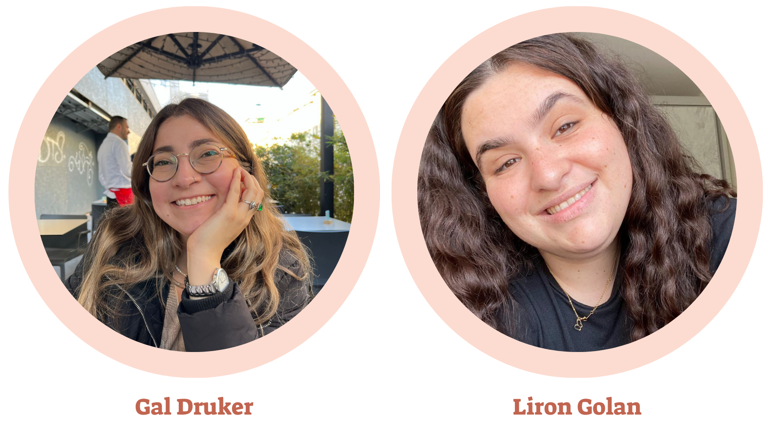
About Us
Notes:
גל -
אנחנו גל ולירון, סטודנטיות שנה ד' למסלול לימודי ערב באפקה

Slide 3
Introduction
This project aims to enhance the support systems for survivors of sexual harassment by developing a digital platform that utilizes sentiment analysis to classify calls from sexual harassment support centers as urgent or non-urgent. The platform consists of a web application with both user-facing and administrative interfaces, built using modern web technologies.

Slide 4
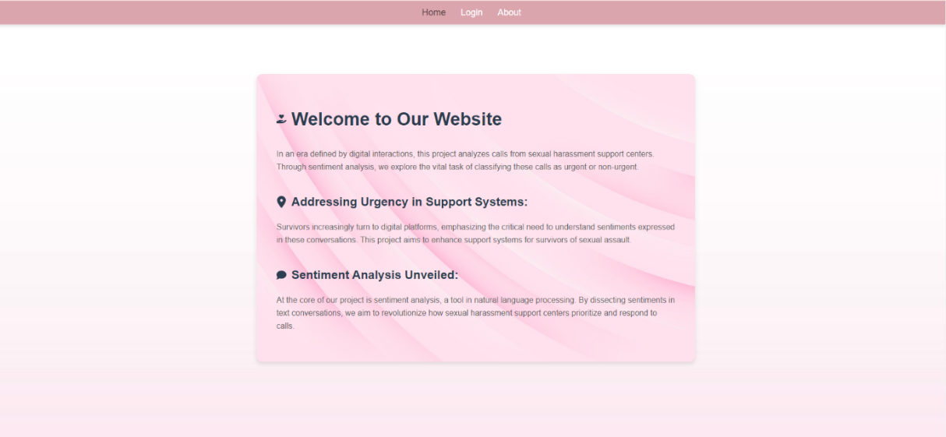
Home
Screens
This is a landing page showcasing the application's features and information. It also showcases the project's goal of analyzing digital interactions and sentiments expressed in conversations related to sexual harassment support.

Slide 5
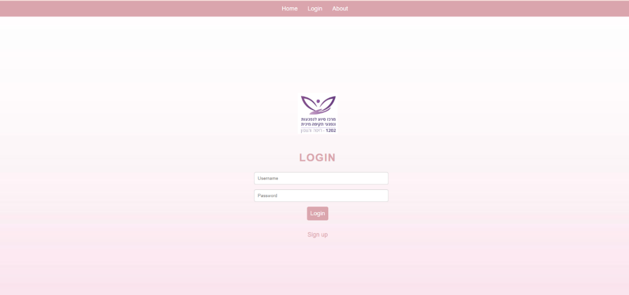
Login
(Before login)
Screens
This is the user authentication page for logging into the application. It includes a form for users to input their credentials (username and password) to authenticate and gain access to secure areas of the project.

Slide 6
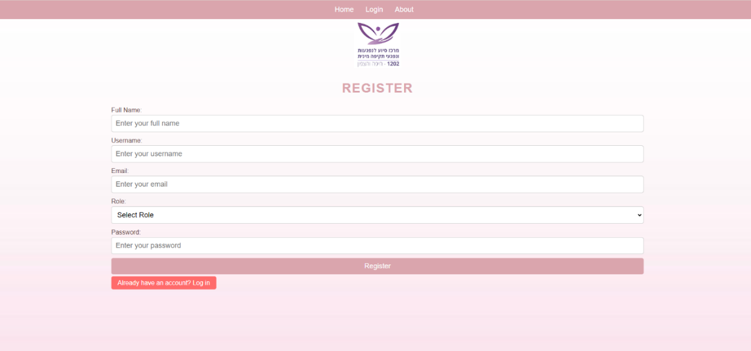
Register (from the Login Page)
(Before login)
Screens
This is the user registration page, accessible from the login screen. It includes form fields for entering user details and incorporates validation logic to ensure data integrity. After registration, the user must wait for an admin to approve him to use the NLP analysis tool.

Slide 7
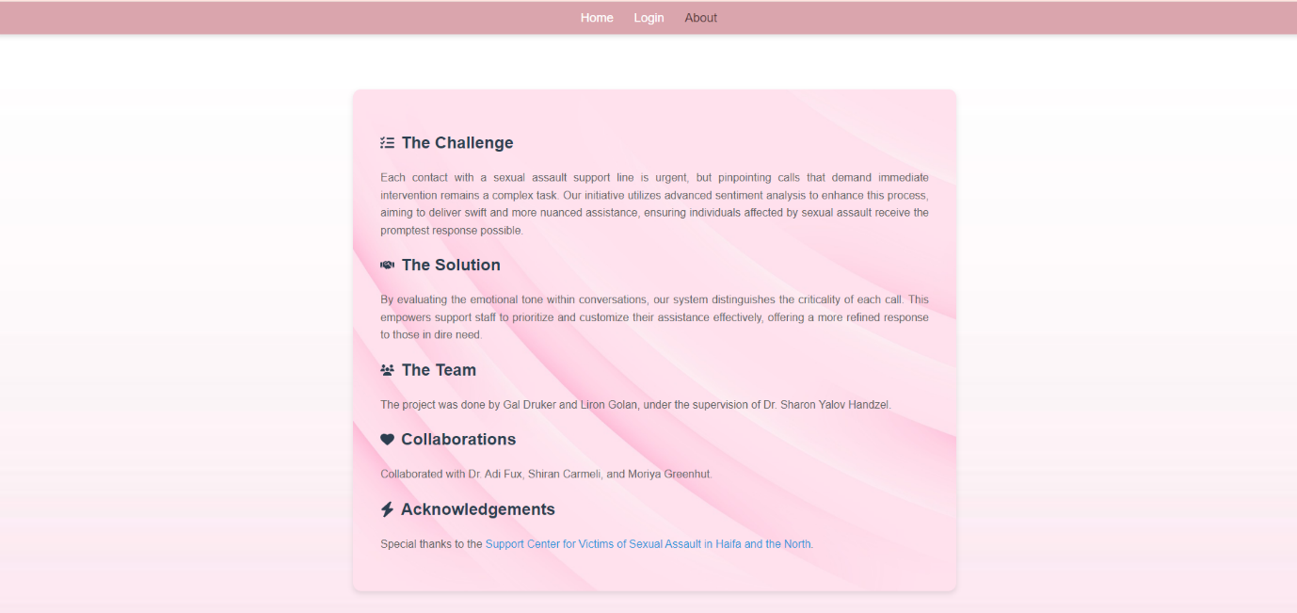
About
Screens
This is an information page detailing the application's purpose and overview. It covers project details, challenges, solutions, team members, collaborations, acknowledgments, and project goals.

Slide 8
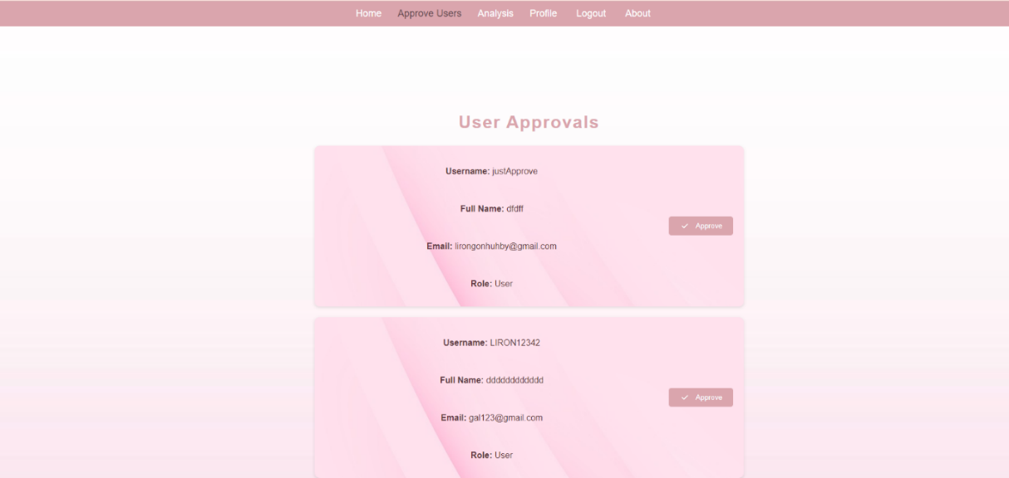
Approve Users
(After login – Admin Only)
Screens
An admin panel or feature for reviewing and approving user registrations. It displays unapproved user details and highlights features for admins to approve users based on their roles.

Slide 9
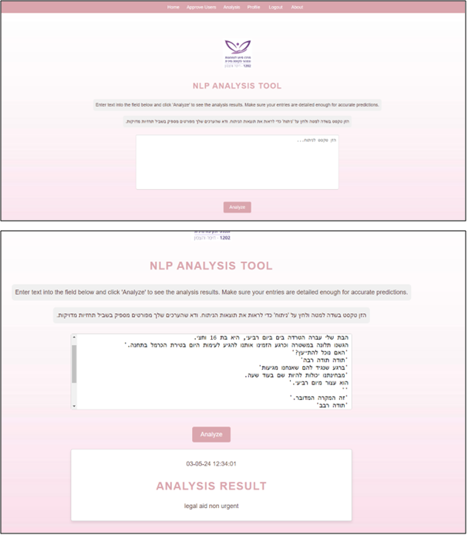
Analysis
(After login)
Screens
Tool for performing natural language processing (NLP) analysis on provided text data. It demonstrates a text input field where users can submit text for analysis, showcasing the practical application of sentiment analysis.

Slide 10
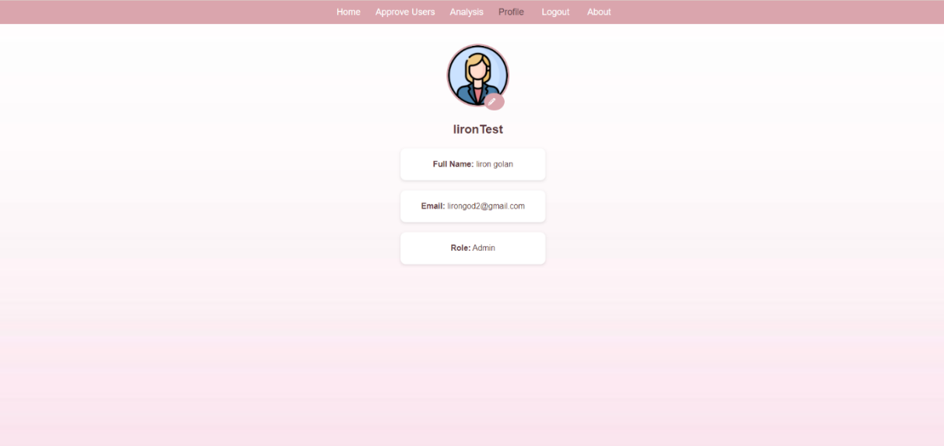
Profile
(After login)
Screens
This is a user profile page with account settings and personal information. It displays user information, including profile images, and allows users to change their picture.

Slide 11
Data Analysis and Preprocessing
Data Cleaning Techniques
Initial Data Assessment:
- Pre-classified data as a benchmark
- Unclassified data tagged using Hepstylex LexiconsAPI
Tagging Unclassified Data:
- Semantic and sentiment analysis
- Emotional categories: despair, loneliness, emotional overflow, self-blame, anxiety, distrust/confusion
Steps:
- HTML Tags Removal
- Emoji and Special Characters Removal
- Diacritics Removal
- Numbers Removal
- Punctuation Normalization
- Normalization of Hebrew Text

Slide 12
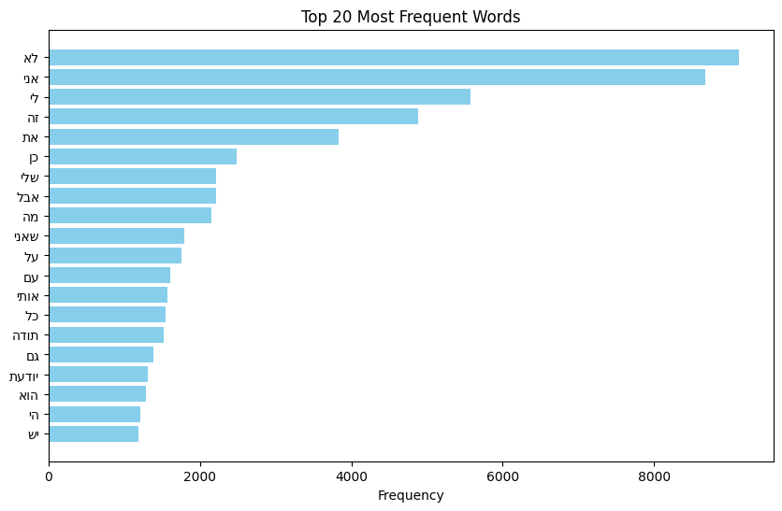
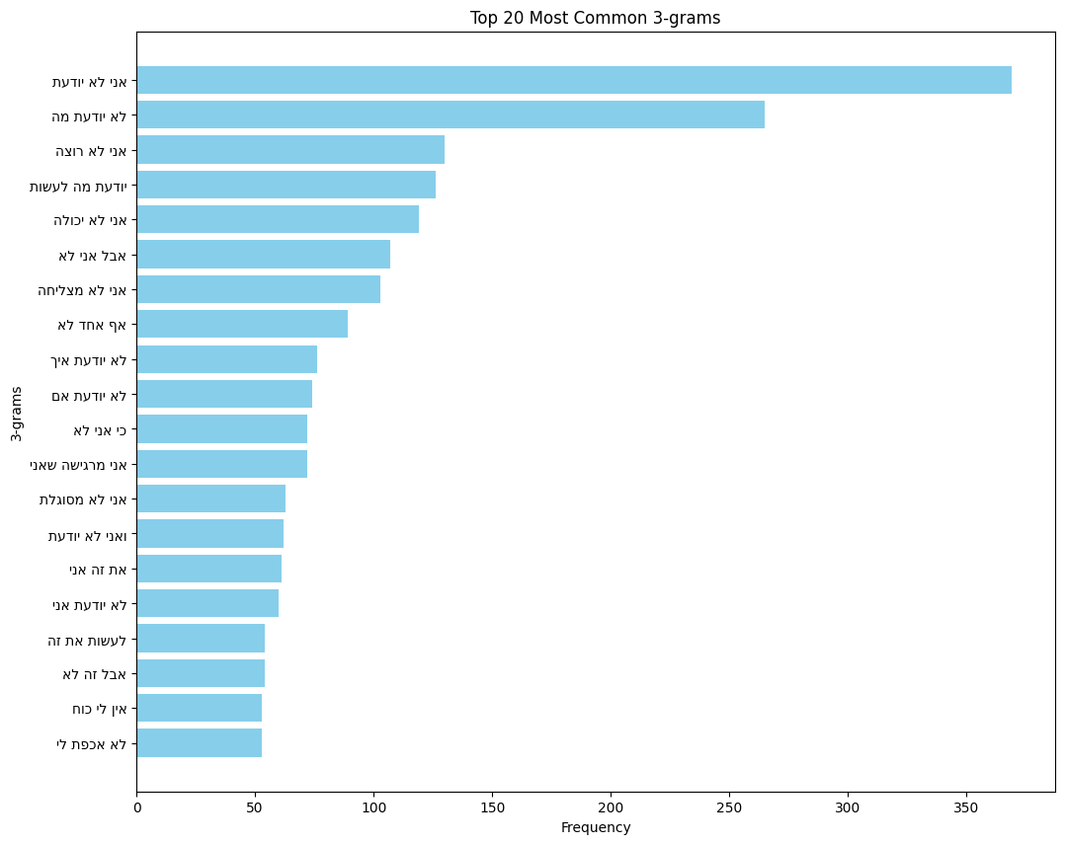
Data Visualization and Insights

Slide 13
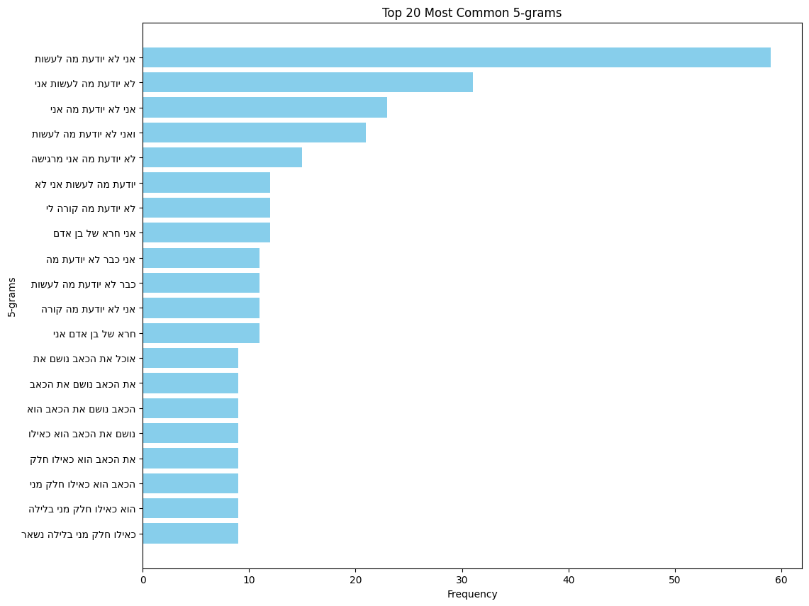
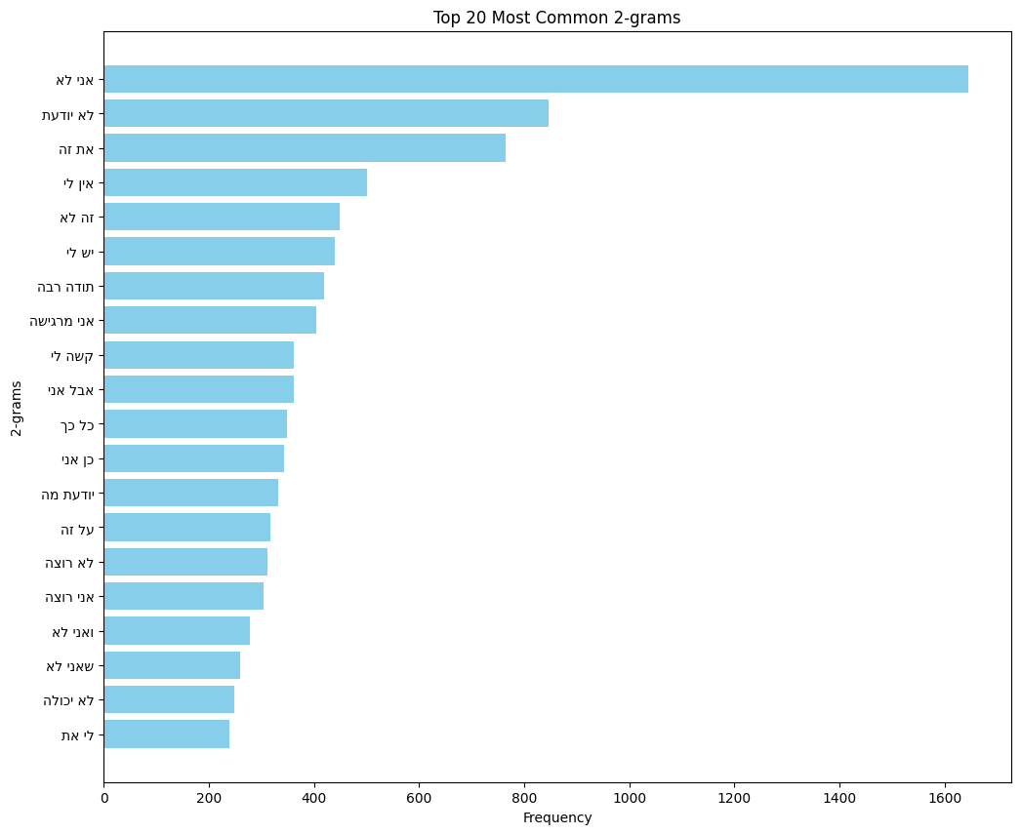
Data Visualization and Insights

Slide 14
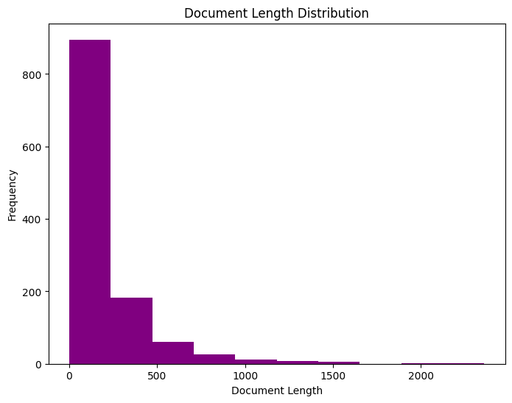
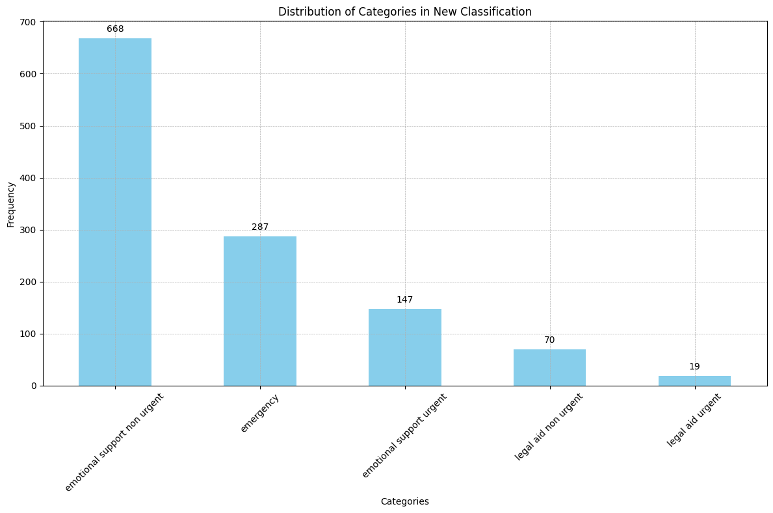
Data Visualization and Insights

Slide 15
Model Development and Evaluation
API Development
Data Preparation:
- Fixed seed for consistency
- Label Encoder for categorical labels
- Random Over Sampling for class balance
Model Setup and Training:
- Pre-trained transformer model: onlplab/alephbert-base
- Fine-tuning and early stopping mechanism
- Model and Tokenizer Saved
- API Design:
- Handles incoming text data
- Preprocessing
- Model prediction
- Returns classification

Slide 16
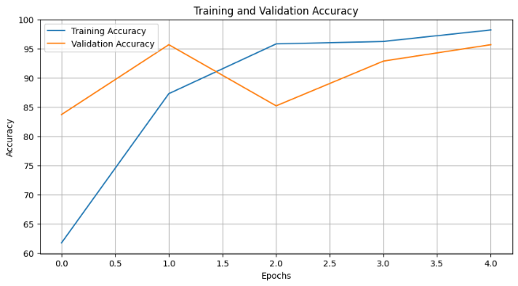
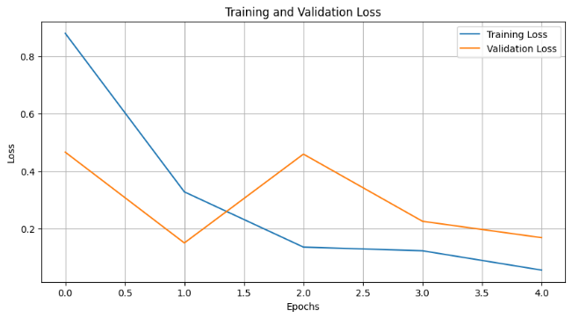
Visualization of Model Performance
Initial Tests:
- Overall accuracy: 17.8%
Validation and Testing:
- Improved validation accuracy: 95.7%
- Consistent test accuracy: 94.01%

Slide 17
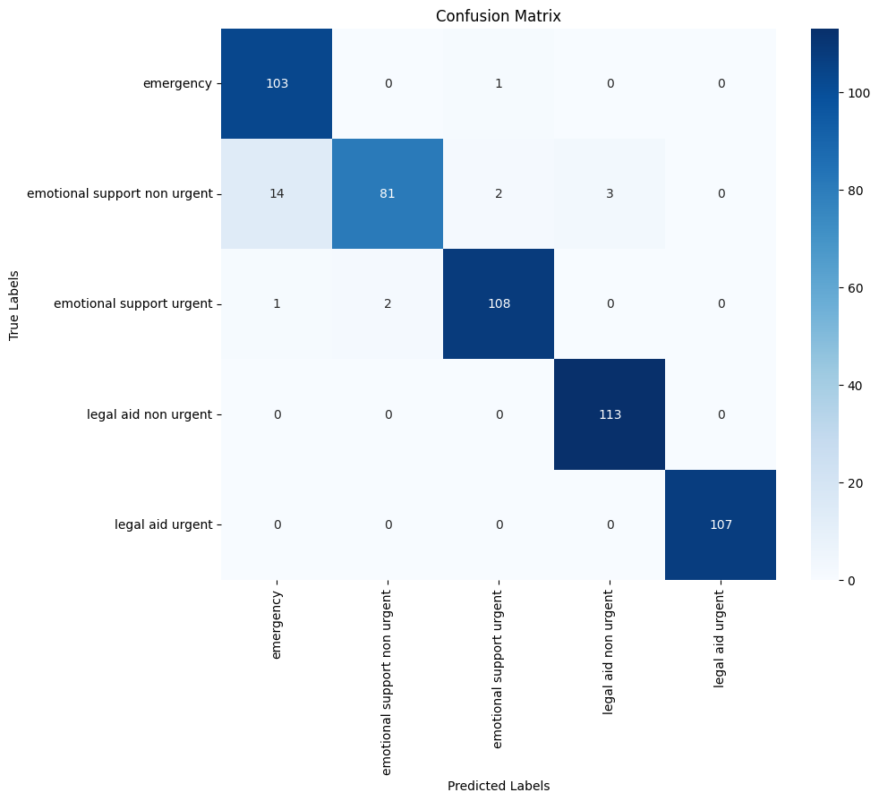
Visualization of Model Performance

Slide 18
Technologies Used
Frontend: React.js, React Router, FontAwesome, CSS for styling.
Backend:
Node.js with Express.js for handling server logic and routing.
Python with Flask as the web framework for its simplicity and flexibility in building RESTful APIs for the sentiment analysis model.
Database: PostgreSQL with SQL for database schema and queries.

Slide 19
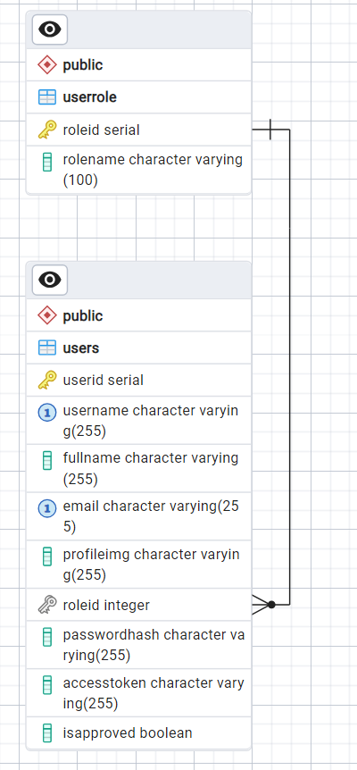
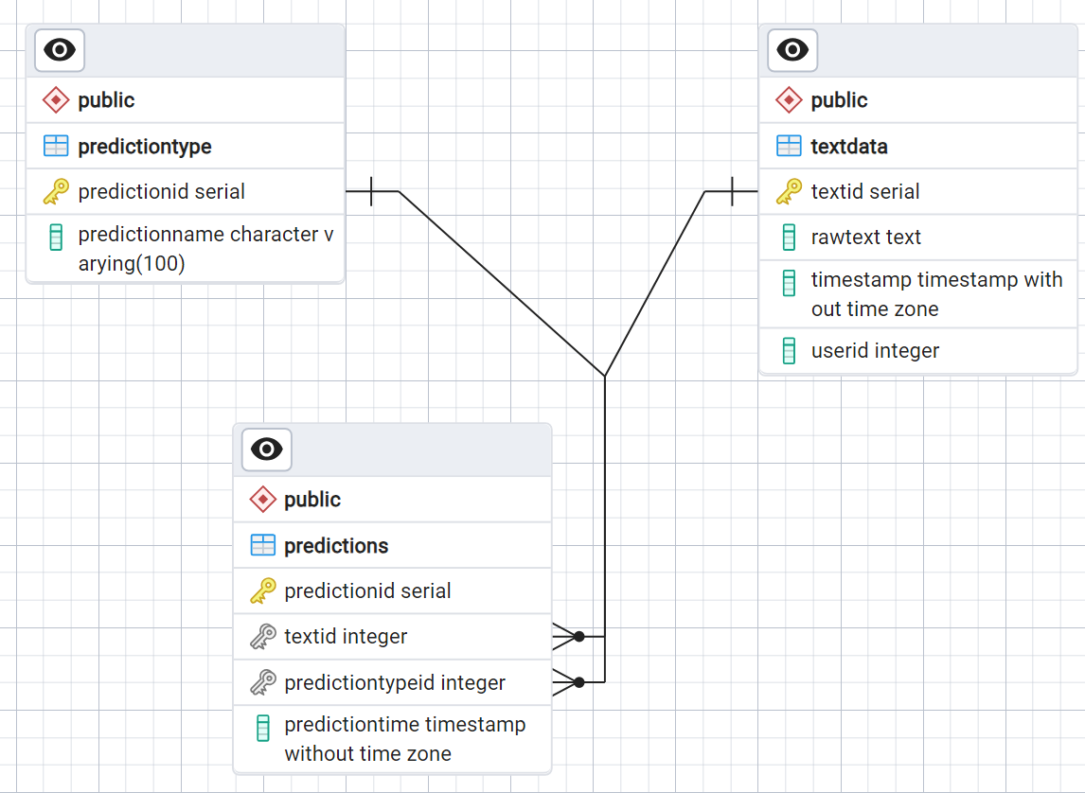
ERD

Slide 20
Code

Slide 21
The project was done by Gal Druker and Liron Golan, under the supervision of Dr. Sharon Yalov Handzel. Collaborated with Dr. Adi Fux, Shiran Carmeli, and Moriya Greenhut.
Special thanks to the Support center for Victims of sexual assault in Haifa and the North.
Notes:
גל –
Sentiment Analysis למוקדי סיוע לתקיפה מינית
הפרויקט בוצע על ידי גל דרוקר ולירון גולן, הפרויקט נעשה תחת פיקוחה של ד"ר שרון ילוב הנדל.
אנו רוצים גם להודות למשתפות הפעולה שלנו, ד"ר עדי פוקס, שירן כרמלי ומוריה גרינהוט והמידע שאנחנו מקבלות הוא הודות למרכז התמיכה לנפגעות תקיפה מינית בחיפה והצפון.

Slide 22
Questions?
Notes:
שאלות?

